Slide 1


Improving Representation Learning Using VAEs and Applications in Anomaly Detection
Shuyu Lin
2016 AIMS cohort,
Cyber Physical Systems Group,
Department of Computer Science,
University of Oxford

Slide 2
Overview
What is representation learning
Methods:
  Improving representations in VAE methods
Applications:
  Anomaly detection for time series
"When you go from 10k training examples to 10B training examples, it all starts to work"
Gary Kasparov,
Deep Thinking: Where Machine Intelligence Ends and Human Creativity Begins

Slide 3

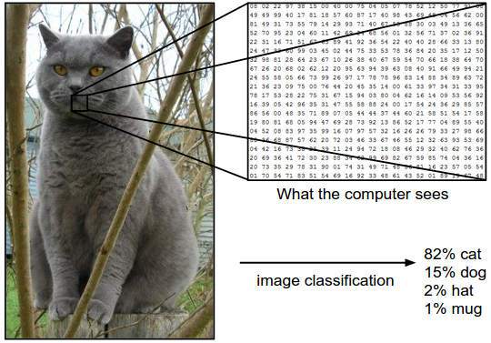
What is Representation Learning?
Difficulty of task depends on representation of information
Summarizes or compresses data
Make it easier to extract information
Used for:
  Input to supervised classifier
  Probabilistic inference
  Manual inspection (interpretability)
[W,P,L]
Cat:
[1,1,0.25]
Dog:
[0,0,0.65]

Slide 4
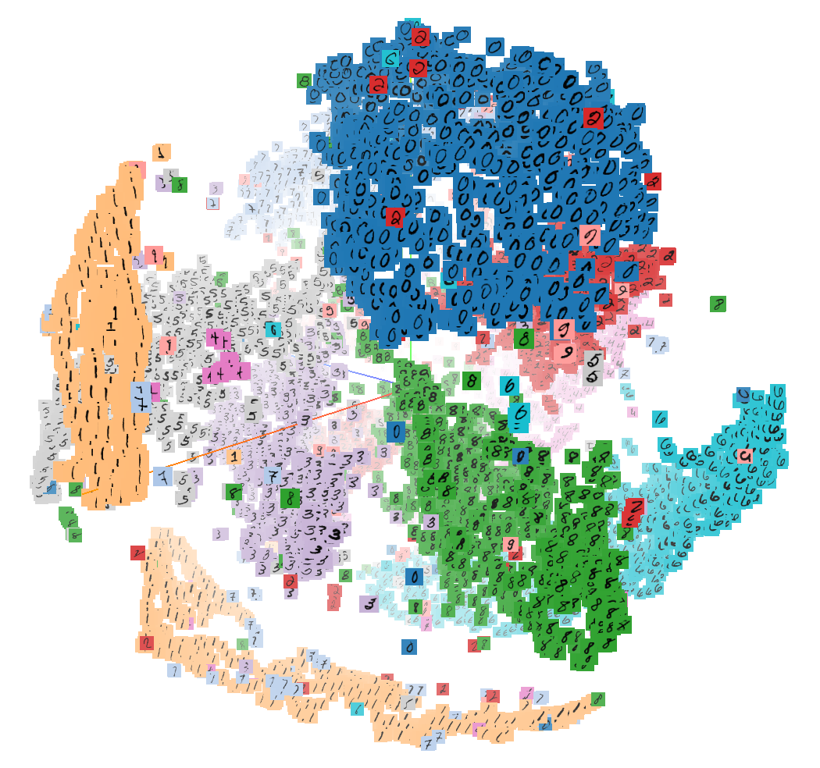
What makes a Good Representation?
Low dimensional
Reusable across tasks
Smooth and spatially coherent
Disentangled
Hierarchical and meaningful

Slide 5
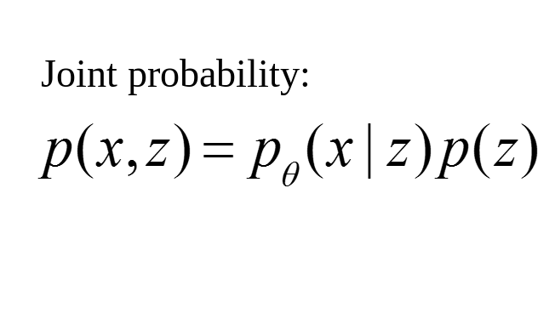
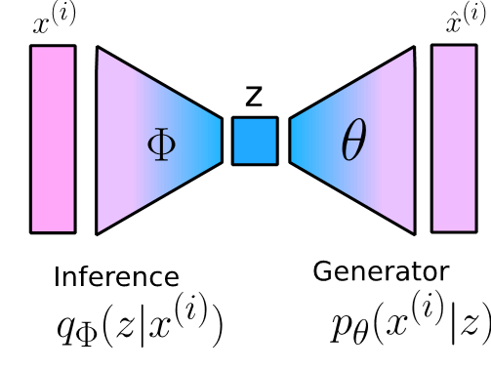
Variational Auto Encoder (VAE)
Generative model of data
Probabilistic formulation
Encoder – decoder model
Low dimensional latent code
Objective contains 2 terms:
  Reconstruction likelihood
  Regularizer

Slide 6
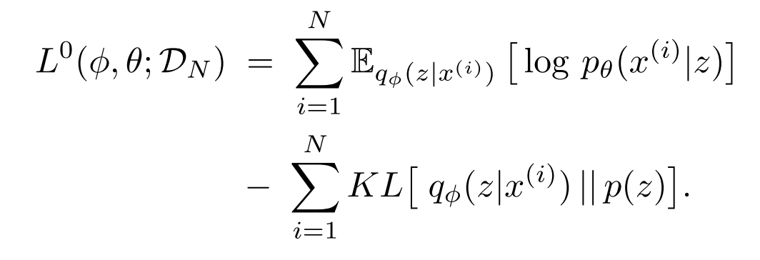
Variational Auto Encoder (VAE)
Reconstruction error
Prior constraint

Slide 7
Variational Auto Encoder (VAE)
Reconstruction error
Prior constraint

Slide 8
Variational Auto Encoder (VAE)
Reconstruction error
Prior constraint

Slide 9
Variational Auto Encoder (VAE)
Reconstruction error
Prior constraint

Slide 10
Variational Auto Encoder (VAE)
Reconstruction error
Prior constraint
Over regularisation

Slide 11

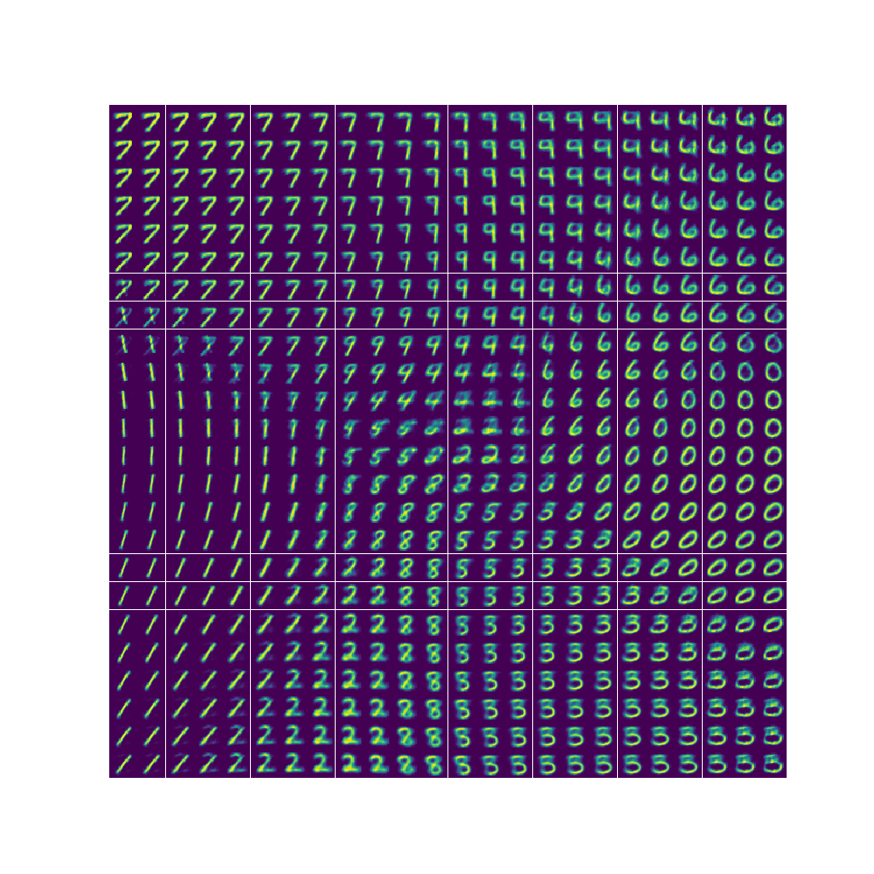
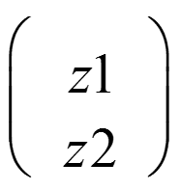
Variational Auto Encoder (VAE)
Reconstruction error
Prior constraint
Model
-2.5
Over regularisation
Latent dim z2
2.5
-2.5
Latent dim z1
2.5
Latent Space

Slide 12


Our Solution
Achieve automatic balance between the reconstruction loss and regularisation in VAE EBLO Objective
Reconstruction error
Prior constraint
Gaussian assumption for the likelihood
Take log

Slide 13
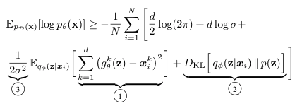
Our Solution
Achieve automatic balance between the reconstruction loss and regularisation in VAE EBLO Objective
Reconstruction error
Prior constraint
Overall ELBO
Natural weighting

Slide 14
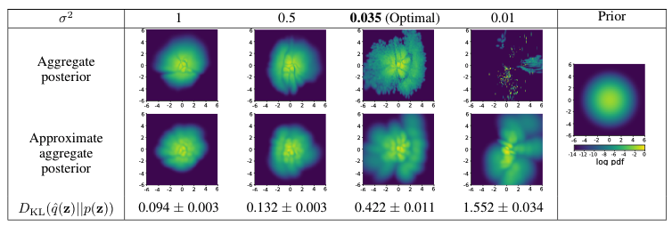
What is the impact of the weighting σ²?
Over
regularisation
Optimal
regularisation
Under
regularisation

Slide 15
What is the impact of the weighting σ²?
Ours
Original VAE

Slide 16
What is the impact of the weighting σ²?
A sensible estimation of generation uncertainty

Slide 17
Anomaly detection for time series
Use VAE to configure the distribution in a low dimensional latent space of the normal behaviours
Use the ELBO loss to indicate uncommon events in the time series

Slide 18
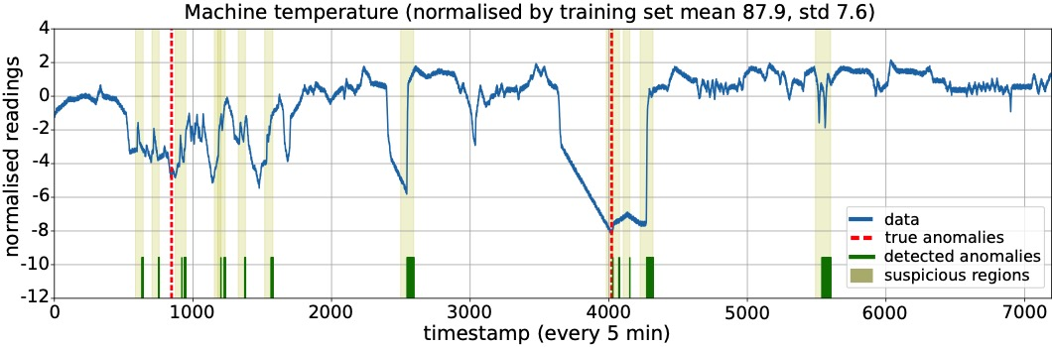
Anomaly detection for time series

Slide 19
Thank you!
Any questions?
Please check out our paper on arXiv:
Balancing reconstruction quality and regularisation in VAEs.
Email: slin@robots.ox.ac.uk
Website: shuyulin.co.uk
Follow me on Twitter: @Shuyulin_n
Collaborators:
Ronald Clark (@ronnieclark__)
Funding:
ABB
China Scholarship Council
Supervisors:
Steve Roberts
Niki Trigoni
Robert Birke

